Slide 1

WNE UW
Topic 2.2
The Constrained Optimization - the foundation of modern microeconomics
Notes:
1

Slide 2
Overview of today lecture
One optimization problem in two forms — primal and dual — is sufficient to move from modeling the “atom” (consumer, producer) to modeling the whole economy.
A brief overview of solving constrained optimization problems using the Lagrangian method; Primary and dual problems
Foundations of General Equilibrium Models and Computable General Equilibrium (CGE) Models

Slide 3
Overview of today lecture
Most economic theories assume that economic agents optimize their behavior to achieve the best possible outcome. This behavior is translated into a model, framed as an optimization problem: consumers aim to maximize utility, while firms focus on minimizing costs and maximizing profit.
In the last lectures, I discussed unconstrained optimization. Today, we will explore constrained optimization, using examples from consumer and producer choices. Ninety percent of economic calculations involve either unconstrained or constrained optimization. I’ll demonstrate that a solid understanding of these concepts is enough to construct a simple General Equilibrium Model.
We’ll go into more detail as we dive deeper into producer and consumer theory..

Slide 4


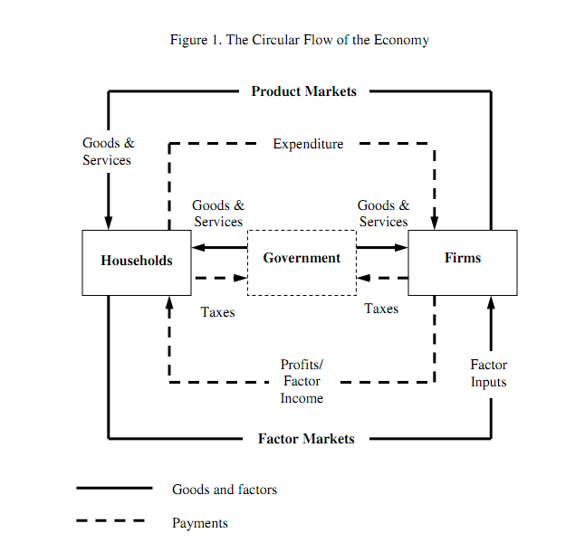


Welcome to the Arrow–Debreu world (general equilibrium)
Today, general-equilibrium models dominate macroeconomics. We start from individual agents (homo oeconomicus) and end with the whole economy. Kenneth Arrow and Gérard Debreu did what physics could not: a model of atomic behaviour does not explain the behaviour of the universe.
Kenneth Arrow
Economics consists of:
• N1 consumers
• N2 goods and services
• N3 factors of production
• N2 markets for goods and services and their prices
• N3 markets for factors of production and their prices
and a mechanism that ties it all together.
Gérard Debreu

Slide 5
Witamy w świecie Arrow–Debreu (równowagi ogólnej)
Utility function representing preferences
Maximization of U(x1, x2) subject to the budget constrain
Axioms of rational choice
Demand for goods and supply of factors of production
Consumers (the role they play)
They own production factors K and L, sell them on the market, and consume them, maximizing utility.
Markets connecting both sides:
Markets for factors of production and for goods and services
Supply of goods and services and demand for factors of production
Producers (the role they take) buy K and L to produce to maximise profit.
Cost minimization for a given output Y(K, L)
Axioms defining technology
Production function

Slide 6
Overview of today lecture
Most economic theories assume that economic agents optimize their behavior to achieve the best possible outcome. This behavior is translated into a model, framed as an optimization problem: consumers aim to maximize utility, while firms focus on minimizing costs and maximizing profit.
In the last lectures, I discussed unconstrained optimization. Today, we will explore constrained optimization, using examples from consumer and producer choices. Ninety percent of economic calculations involve either unconstrained or constrained optimization. I’ll demonstrate that a solid understanding of these concepts is enough to construct a simple General Equilibrium Model.
We’ll go into more detail as we dive deeper into producer and consumer theory..

Slide 7
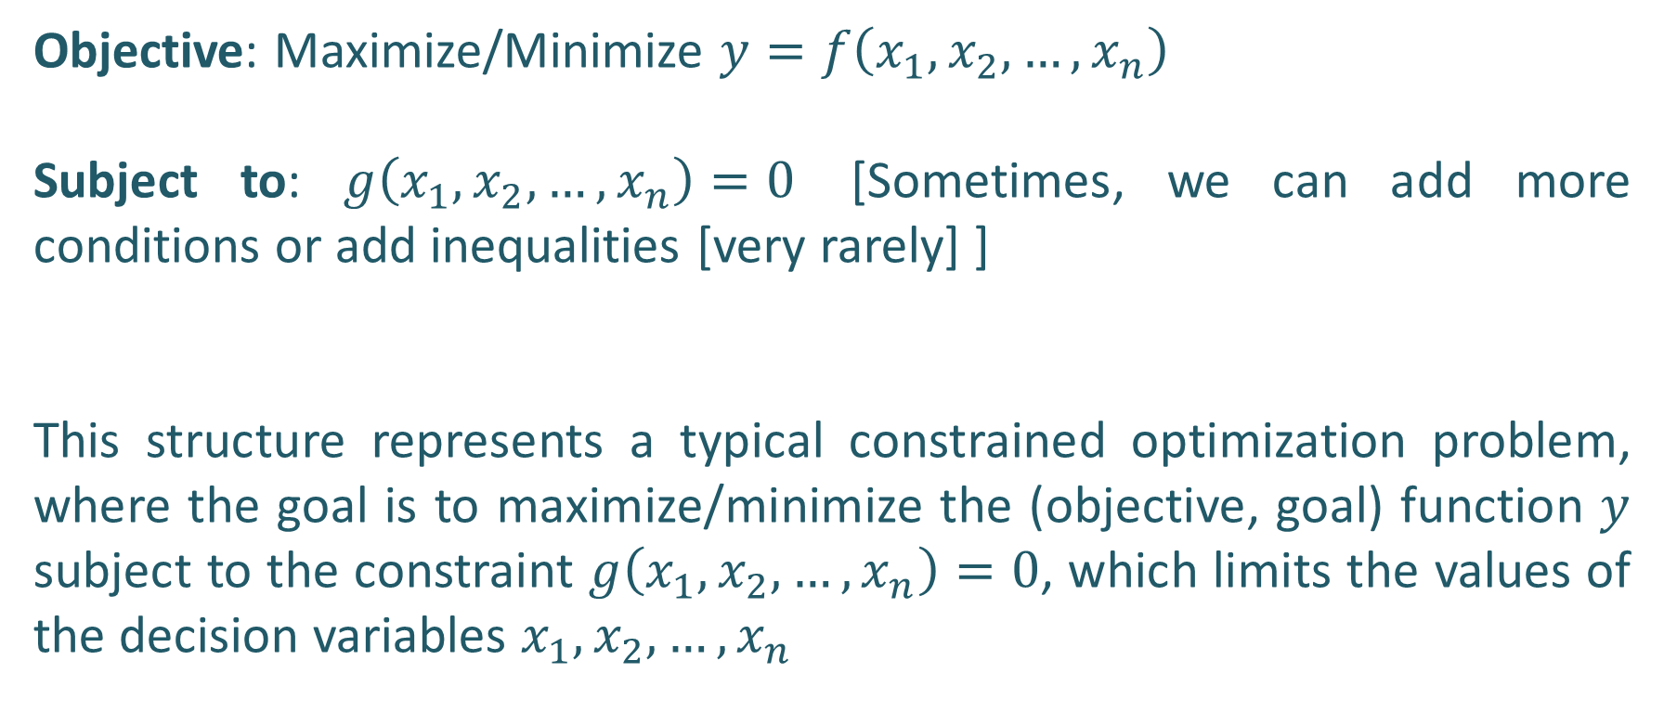
Lagrangian Multiplier Method
Objective: Maximize/Minimize $y=f\left(x_{1},x_{2},…,x_{n}\right)$
Subject to: $g\left(x_{1},x_{2},…,x_{n}\right)=0$ [Sometimes, we can add more conditions or add inequalities [very rarely] ]
This structure represents a typical constrained optimization problem, where the goal is to maximize/minimize the (objective, goal) function $y$ subject to the constraint $g\left(x_{1},x_{2},…,x_{n}\right)=0$, which limits the values of the decision variables $x_{1},x_{2},…,x_{n}$

Slide 8
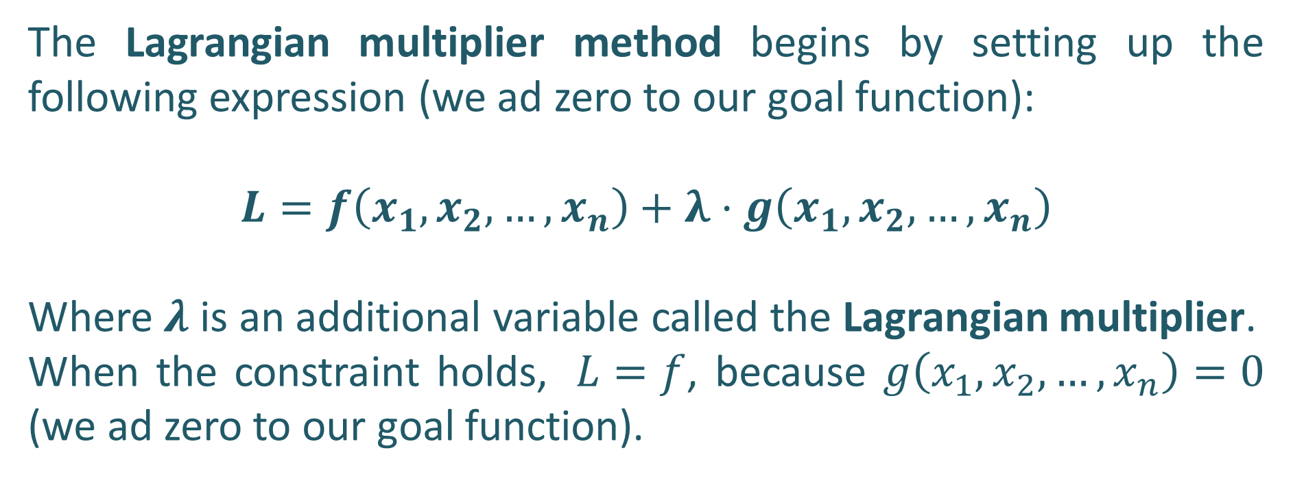
Lagrangian Multiplier Method
The Lagrangian multiplier method begins by setting up the following expression (we ad zero to our goal function):
$$L=f\left(x_{1},x_{2},…,x_{n}\right)+λ⋅g\left(x_{1},x_{2},…,x_{n}\right)$$
Where $λ$ is an additional variable called the Lagrangian multiplier.
When the constraint holds, $L=f$, because $g\left(x_{1},x_{2},…,x_{n}\right)=0$ (we ad zero to our goal function).

Slide 9

Lagrangian Multiplier Method; First-Order Conditions
For a function $f\left(x_{1},x_{2},…,x_{n}\right)$ subject to the constraint $g\left(x_{1},x_{2},…,x_{n}\right)=0$, the first-order conditions are derived as follows:
$$\begin{matrix}\frac{∂L}{∂x_{1}}=f_{1}+λg_{1}=0 \\ \frac{∂L}{∂x_{2}}=f_{2}+λg_{2}=0 \\ \begin{matrix}⋮ \\ \begin{aligned}\frac{∂L}{∂x_{n}}=f_{n}+λg_{n}=0 \\ \end{aligned} \\ \frac{∂L}{∂λ}=g\left(x_{1},x_{2},…,x_{n}\right)=0 \end{matrix}\end{matrix}$$

Slide 10
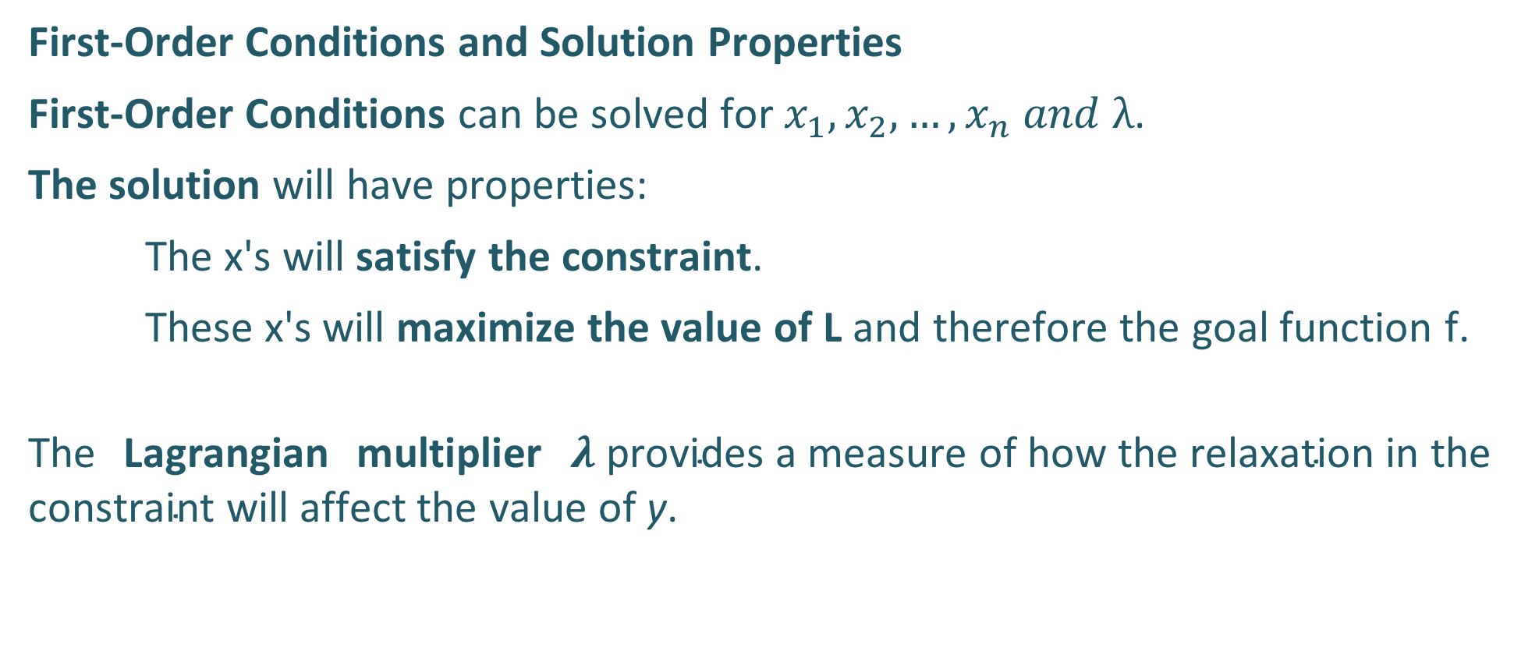
Lagrangian Multiplier Method
First-Order Conditions and Solution Properties
First-Order Conditions can be solved for $x_{1},x_{2},…,x_{n} ​and λ$.
The solution will have properties:
    The x's will satisfy the constraint.
    These x's will maximize the value of L and therefore the goal function f.
The Lagrangian multiplier $λ \text{provides} \text{a} \text{measure} \text{of} \text{how} \text{the} \text{relaxation} \text{in} \text{the} \text{constraint} \text{will} \text{affect} \text{the} \text{value} \text{of} \text{y}$.

Slide 11
Lagrangian Multiplier Method
Second-order conditions that describe the curvature of the function must be checked. For minimization, the Hessian of the Lagrangian must be positive semidefinite, while for maximization, it must be negative semidefinite.
However, we typically select a goal function that satisfy these conditions (our discussions about the production function).
For those interested in more mathematical rigor, refer to the following link for a detailed explanation of the Kuhn–Tucker conditions: https://www.cs.cmu.edu/~ggordon/10725-F12/slides/16-kkt.pdf
[As a final paper, you can prepare a cheat sheet based on Polish materials [previous final papers] in Maxima, Python, (symbolic/numerical calculation) and in R (only numerical)]

Slide 12
Lagrangian Multiplier Method
A constrained optymalization problem can have an associated dual problem that focuses on the constraints in the original problem.
  Primal problem: Consumers maximize utility subject to a budget constraint
  Dual problem: consumers minimize the expenditure needed to achieve a given level of utility
  Primal problem: Firms minimize the cost of inputs to produce a given level of output
  Dual problem: firms maximize output for a given cost of inputs purchased
Typically, for consumers, we use the primal problem (maximizing utility), while for firms, we use the dual problem (minimizing costs).

Slide 13

Utility maximization - preferences
Rational choice theory makes some basic assumptions (axioms) about the preferences of homo economicus:
  Completeness - all alternatives can be ranked. If A and B are any two alternatives, an individual can always specify exactly one of these possibilities: i) A is preferred to B ii) B is preferred to A iii) A and B are indifferent
  Transitivity - if alternative A is preferred to B, and alternative B is preferred to C, then A is preferred to C.
  We can add more axioms, but they mainly have technical implications and do not constitute a core of rationality assumption.

Slide 14
Utility maximization - preferences
Non-Satiation (Monotonicity) -> More of a good is always better (or at least not worse) than less, assuming the additional amount is desirable.
Continuity -> Small changes in outcomes result in small changes in preferences. This means that if A is preferred over B and B over C, there exists some mix of A and C that is equally as preferred as B.
Independence of Irrelevant Alternatives -> Preferences between options should remain consistent, even if additional options are introduced. If A is preferred over B in a choice set, then introducing a third option C should not change the preference for A over B.
Consistency -> Choices are consistent over time and context; if a decision-maker prefers A over B today, they should prefer A over B in similar situations in the future.

Slide 15
Utility maximization - preferences
Convexity (for preferences) -> means that individuals prefer averages or mixes of extreme choices. For example, if an agent is indifferent between A and B, they would also be indifferent to a mix of A and B.
Independence from Social or Group Preferences – Individual preferences are unaffected by others’ choices.
…. More ……
Together these assumptions ensure that preferences are consistent --> we can predict the behaviour of homo oeconomicus and need some of them to have the possibility of obtaining a "nice” mathematical representation of preferences as a utility function.

Slide 16
Utility maximization – utility function
We assume that people are able to rank in order all possible situations from least desirable to most. We can find a function, which maps the ranking -> utility function. If A is preferred to B, then the utility assigned to A exceeds the utility assigned to B
U(A) > U(B)
Well-behaving preferences give us well-behaving utility function, which is continuous and monotonically increasing, the second derivative of the function is negative => the law of diminishing marginal utility [mixture of technical and bahavioral assumption]

Slide 17
Lagrangian Multiplier Method
The properties of the utility function are similar to those discussed for the production function (we will use the same Cobb-Douglas function), but its interpretation is different.
The utility function represents ordinal preferences (e.g., A is better than B, but we do not measure by how much), so there is no need to analyze scale effects or homogeneity. The utility function can also be transformed monotonically, and such transformations do not change the ordinal ranking of preferences. A common trick to make life easier is to take the logarithm of a utility function, this makes the function easier to manipulate and can help find extrema.

Slide 18
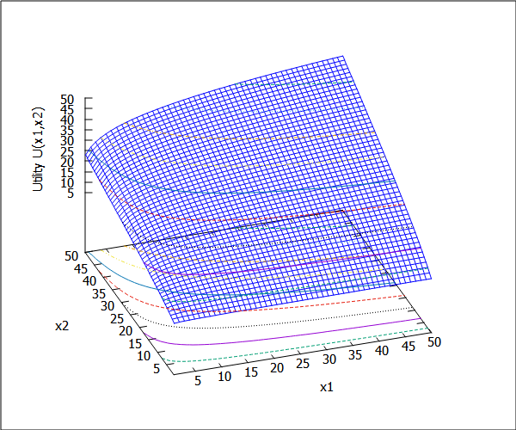
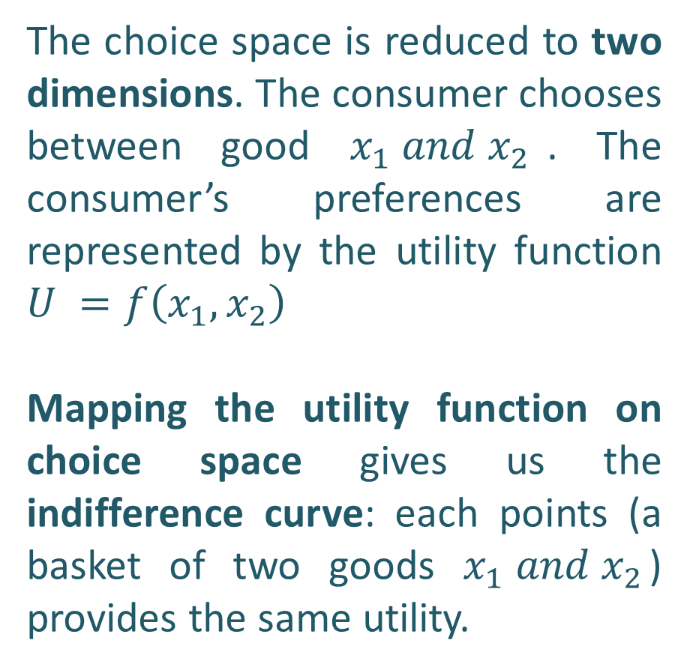
  Utility maximization – utility function
The choice space is reduced to two dimensions. The consumer chooses between good $x_{1} ​and x_{2}$​. The consumer’s preferences are represented by the utility function $U =f\left(x_{1},x_{2}\right)$
Mapping the utility function on choice space gives us the indifference curve: each points (a basket of two goods $x_{1} ​and x_{2}$​) provides the same utility.

Slide 19
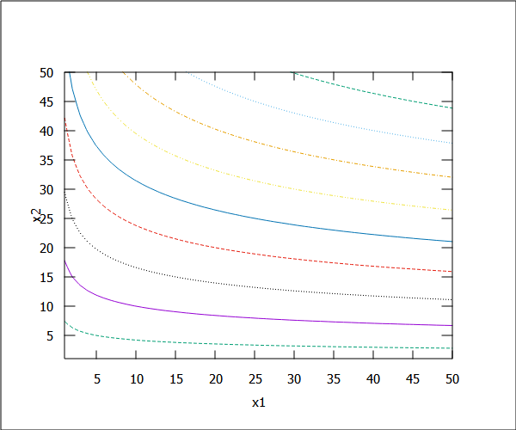
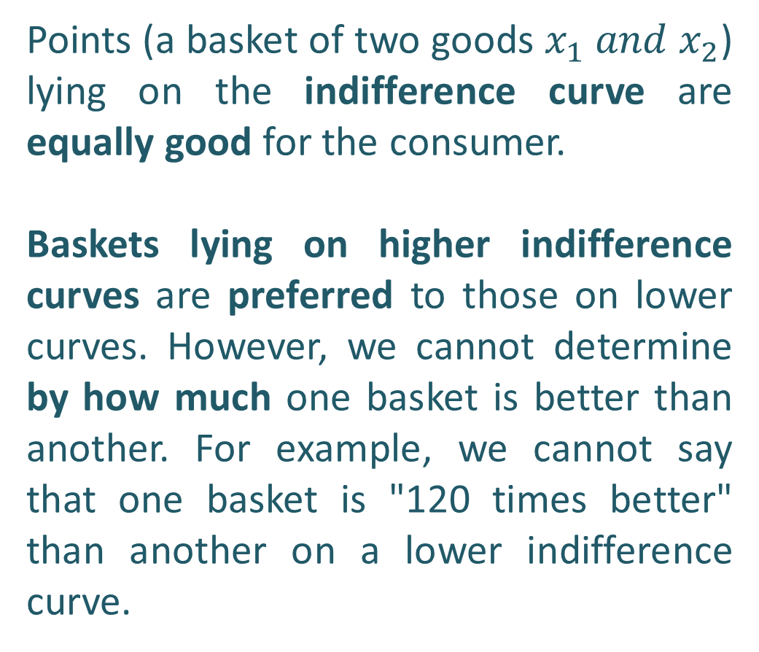
  Utility maximization – utility function
Points (a basket of two goods $x_{1} ​and x_{2}$​) lying on the indifference curve are equally good for the consumer.
Baskets lying on higher indifference curves are preferred to those on lower curves. However, we cannot determine by how much one basket is better than another. For example, we cannot say that one basket is "120 times better" than another on a lower indifference curve.

Slide 20
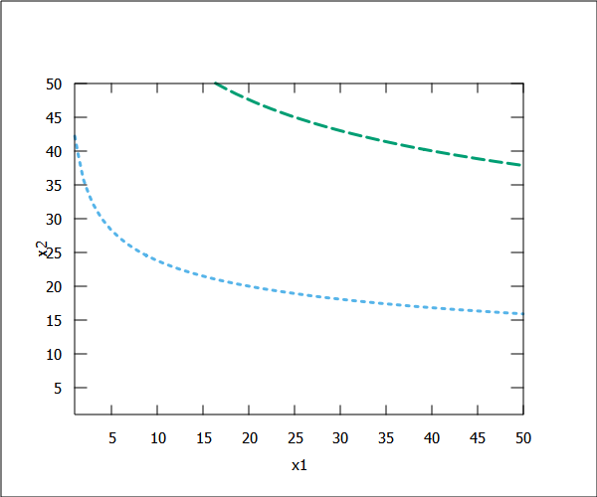
  Utility maximization – utility function
Moving along the indifference curve does not change the utility. We can calculate the change in utility, ΔU, using the total differential.
Since utility remains constant along the indifference curve, ΔU = 0.
The Marginal Rate of Substitution (MRS) is essentially a measure of how much of one good a person is willing to give up to gain an additional unit of another good, keeping the utility level constant.
Δx₂
Δx₁

Slide 21
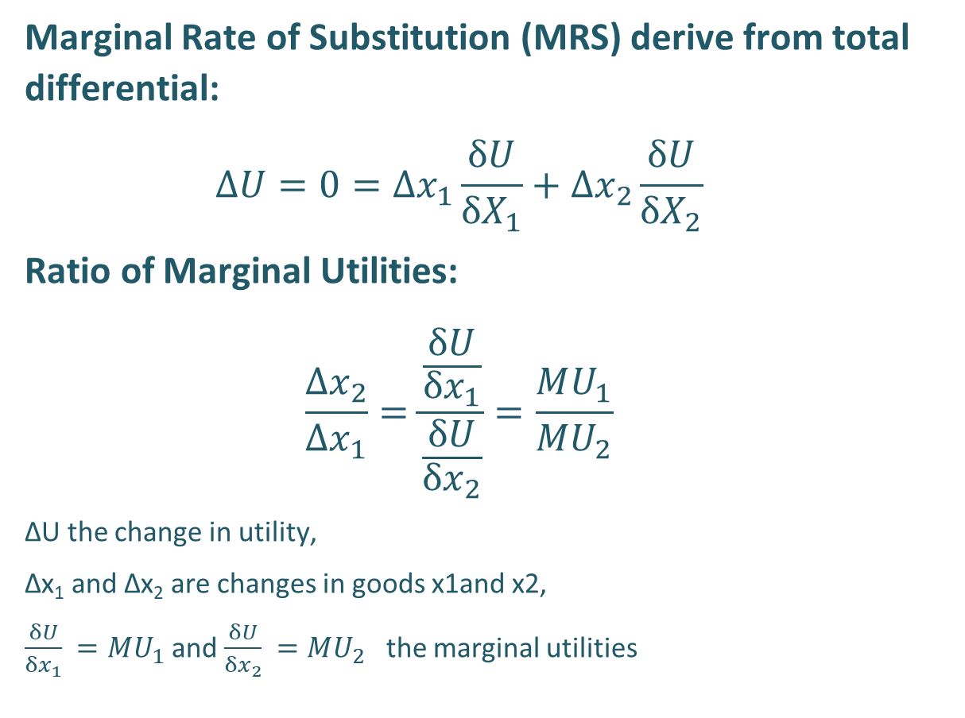
  Utility maximization – utility function
Marginal Rate of Substitution (MRS) derive from total differential:
$$ΔU=0=Δx_{1}\frac{δU}{δX_{1}}+Δx_{2}\frac{δU}{δX_{2}}$$
Ratio of Marginal Utilities:
$$\frac{Δx_{2}}{Δx_{1}}=\frac{\frac{δU}{δx_{1}}}{\frac{δU}{δx_{2}}}=\frac{MU_{1}}{MU_{2}}$$
ΔU the change in utility,
Δx₁​ and Δx₂​ are changes in goods x1and x2​,
$\frac{δU}{δx_{1}} =MU_{1}$and $\frac{δU}{δx_{2}} =MU_{2}$ ​ the marginal utilities
Δx₂
Δx₁

Slide 22
  Utility maximization Psychological Perspective on MRS
MRS defines our psychological exchange relations (we can substuitute one good by another in given proportion and it not change our sytuation) . The law of diminishing MRS fits with human behavior – we value what we lack.
A: We have a lot of x2 and a little x1​
  Psychological Insight: We value what we lack – x1​ is valued more.
  Behavior: Willing to trade 5 units of x2​ for 1 unit of x1
B: We have a lot of x1 and a little x2
  Psychological Insight: Now x2​ is more valuable.
  Behavior: Willing to trade only 1/2 unit of x2​ for 1 unit of x1​.
x₂
MRS = (-) 5
A
Δx₂
x’
B
MRS = (-) 0.5
Δx₁
x₁

Slide 23
Utility maximization - budget constraint
The consumers have finite resources. We assume that consumers spend all their income (there are no savings in this model; if we want to allow for savings, we treat them as an additional variable).
Therefore, consumer spending can be represented by budget constraint of the form: p₁x₁ + p₂x₂ +…+ p_{n}x_{n} = M.
The budget constraint is defined by the market: M and prices p1, p2 are given - the external world defines HO possibility of consumption.

Slide 24
Utility - the maximization problem
The consumer choice is simplified to maximization problem with constraints.
Max U(x₁, x₂,…, x_{n})
subject to
p₁x₁ + p₂x₂ +…+ p_{n}x_{n} = M

Slide 25
Utility - the equilibrium
We know the consumer choice. It is defined by an equilibrium condition.
The psychological trade-off between consumption x1 and x2 (MRS) is equal the market trade-off which is set by price relations (p1/p2)
x2
x2*→ demand for x2
U* - maximal level of utility for given p1,p2 and M
x1* → demand for x1
x1

Slide 26
  Utility maximization subject to a budget constraint
Can we find the candy experiment in this case?
Let's assume the market exchange ratio (the slope of the budget constraint) equals (-) 1 --> we can exchange a unit of x1 for a unit of x2 on the "market"
We are at point(basket) A --> MRS = (-)5 --> we are willing to give up 5 units of x2 for 1 unit of x1 and the market tradeoff is 1 to 1 --> it pays to increase x1, because psychologically we gain from the difference in exchange ratios and Marginal Benefit = 5 ≠ Marginal Cost = 1 from exchange.
Point B -> by analogy
MRS = - 5
A
MRS = - 0.5
B
Δx₂
p2/p1 = - 1
Δx₁

Slide 27
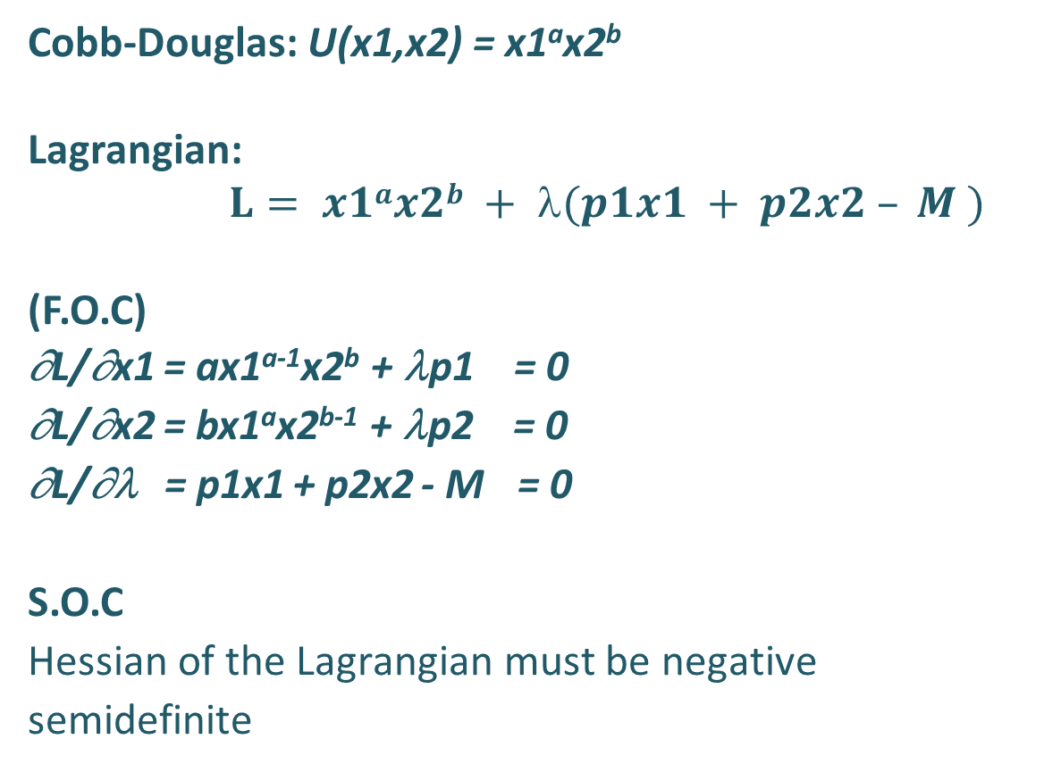
The maximization problem
Cobb-Douglas: U(x1,x2) = x1ªx2^{b}
Lagrangian:
      $$L= x1ax2b + (p1x1 + p2x2 – M )$$
(F.O.C)
∂L/∂x1 = ax1^{a-1}x2^{b} + λp1 = 0
∂L/∂x2 = bx1ªx2^{b-1} + λp2 = 0
∂L/∂λ = p1x1 + p2x2 - M = 0
S.O.C
Hessian of the Lagrangian must be negative semidefinite
Objective function (utility)
kill(all)$ /* Clear all previous variables and functions */
assume(x1>0, x2>0, p1>0, p2>0, u>0, a>0, a<1, b>0,b<1, M>0,lambda>0)$ /* Assume all variables are positive to simplify the solution */
L: (x1^a * x2^b) + lambda * (p1 * x1 + p2 * x2 - M); /* Define the Lagrange function with a utility function and budget constraint */
/* First-order conditions */
eq1: diff(L, x1, 1) = 0; /* Take the first derivative of L with respect to x1 and set it to zero */
eq2: diff(L, x2, 1) = 0; /* Take the first derivative of L with respect to x2 and set it to zero */
eq3: diff(L, lambda, 1) = 0; /* Take the first derivative of L with respect to lambda and set it to zero (budget constraint) */
/* Solve the system of equations for x1, x2, and lambda */
solution: solve([eq1, eq2, eq3], [x1, x2, lambda]);
/* Second-order conditions - Compute the Hessian matrix */
Hessian: matrix(
[diff(L, x1, 2), diff(diff(L, x1), x2)],
[diff(diff(L, x2), x1), diff(L, x2, 2)]
);
/* Evaluate the Hessian at the solution values for x1, x2, and lambda */
Hessian_at_solution: subst(solution, Hessian);
/* Check if the Hessian is negative semi-definite for maximization */
compare(determinant(''Hessian_at_solution),0);
We add zero --> the equation gives zero when our choices satisfy the budget constraint, and there are no savings.

Slide 28
Utility - the equilibrium
$$\left[\left[x1=\frac{M⁢a}{\left(b+a\right)⁢p1},x2=\frac{M⁢b}{\left(b+a\right)⁢p2},λ=−\left(\frac{M^{b+a−1}⁢a^{a}⁢b^{b}⁢{\left(b+a\right)}^{−b−a+1}}{{p1}^{a}⁢{p2}^{b}}\right)\right]\right]$$
Lambda Interpretation:
Increase in utility due to budget increase by 1
Consumption x1, 2 for prices p1 p2 and income M maximizing utility. For the general form --> demand functions x1 = f(p1,p,M), x1 = f(p1,p,M). It is worth noting:
  Income Effect: Demand for both goods positively depends on income M (linear relationship).
  Price Elasticity: Demand functions are nonlinear to the price of the good itself.
  Cross-Price Independence: Demand for x1 does not depend on p2​, and demand for x2​ does not depend on p1​ in this setup.
Question:
  How the expenses for the two goods are related? (Consider the total spending on each good and the impact of price and income changes.)
The next lecture will discuss the issues and whether they are realistic.

Slide 29
Utility - the equilibrium
ACS programs sometime have trouble solving a system of equations like the one above. In “difficult” cases, you can solve it by:
1) By using the MRS = p1/p2 equilibrium and solve the system of equations: MRS=p1/p2 and p1*X1+p2*X2 = M
and / or
2) By substitution -> from the budget constraint, we can obtained one variable as a function of the other and inserted into the objective function to solve a simple one-variable optimization problem.

Slide 30
∂L/∂x1 = ax1^{a-1}x2^{b} + λp1 = 0
∂L/∂x2 = bx1ªx2^{b-1} + λp2 = 0
∂L/∂λ = p1x1 + p2x2 - M = 0
Utility - the equilibrium
ax1^{a-1}x2^{b} = -λp1 0
bx1ªx2^{b-1} = -λp2 0
p1x1 + p2x2 - M = 0
ax1^{a-1}x2^{b} -λp1
-------------- = ---------
bx1ªx2^{b-1} -λp2
ax1^{a-1}x2^{b} p1
-------------- = ---------
bx1ªx2^{b-1} p2
p1x1 + p2x2 - M = 0
MU1 p1
-------- = ------ = MRS
MU2 p2
By using the MRS = p1/p2 equilibrium and solve the system of equations:
    MRS=p1/p2
    and
    p1*X1+p2*X2 = M
ill(all); /* Clear all previous definitions and variables */
assume(x1>0, x2>0, p1>0, p2>0, U>0, a>0, b>0, a<1, b<1, lambda>0);
/* Set assumptions for the variables: x1, x2, p1, p2, U, a, b, and lambda are all positive,
and exponents a and b are between 0 and 1 */
$declare(a, noninteger, b, noninteger);
/* Declare 'a' and 'b' as non-integer values for further symbolic manipulation */
U: x1^a * x2^b;
/* Define the utility function U as a Cobb-Douglas function with exponents 'a' and 'b' */
eq1: diff(U, x1, 1) / diff(U, x2, 1) = p1 / p2;
/* First equation: Set the ratio of marginal utilities equal to the price ratio (p1/p2) */
eq2: p1 * x1 + p2 * x2 - M;
/* Second equation: Budget constraint where total spending (p1*x1 + p2*x2) equals income (M) */
solve([eq1, eq2], [x1, x2]);
/* Solve the system of equations (eq1 and eq2) for the variables x1 and x2 */

Slide 31
Utility - the equilibrium
kill(all)$
/* Step 1: Define variables and parameters */
assume(x1 > 0, x2 > 0, p1 > 0, p2 > 0, M > 0, a > 0, a < 1, A > 0, M > 0)$
declare(a, constant)$
declare(ro, constant)$
declare(M, constant)$
declare(A, constant)$
/* Step 2: Define the CES utility function U */
U: A*( a * x1^(-ro) + (1 - a) * x2^(-ro) )^(-1 / ro )$
/* Step 3: Compute the marginal utilities MU1 and MU2 */
MU1: diff(U, x1)$
MU2: diff(U, x2)$
/* Step 4: Simplify marginal utilities */
MU1_simplified: ratsimp(MU1)$
MU2_simplified: ratsimp(MU2)$
/* Step 5: Compute the Marginal Rate of Substitution */
MRS: MU1_simplified / MU2_simplified$
MRS_simplified: (a / (1 - a)) * (x2 / x1)^(ro + 1)$
/* Step 6: Set MRS equal to the price ratio */
eq_mrs: MRS_simplified = p1 / p2$
/* Step 7: Solve for x1/x2 */
x1_over_x2_expr: (a / (1 - a)) * (p2 / p1)$
x1_over_x2: x1_over_x2_expr^(1 / (ro + 1))$
/* Step 8: Display the ratio x1/x2 */
x1_over_x2_simplified: ratsimp(x1_over_x2)$
print("The ratio x1/x2 is:", x1_over_x2_simplified)$
/* Step 9: Substitute x1 in the budget constraint */
x1_expr: x1_over_x2_simplified * x2$
budget_constraint: p1 * x1_expr + p2 * x2 = M$
/* Step 10: Solve for x2 */
denominator: p1 * x1_over_x2_simplified + p2$
x2_sol: x2 = M / denominator$
/* Step 11: Compute x1 using x1 = (x1/x2) * x2 */
x1_sol: x1 = x1_over_x2_simplified * x2_sol$
/* Step 12: Simplify the demand functions */
x1_demand: ratsimp(x1_sol)$
x2_demand: ratsimp(x2_sol)$
/* Step 13: Display the demand functions */
print("Demand function for x1:", x1_demand)$
print("Demand function for x2:", x2_demand)$
By using the MRS = p1/p2 equilibrium and solve the system of equations: MRS=p1/p2 and p1*X1+p2*X2 = M
and
By substitution ->from the budget constraint, one variable is obtained as a function of the other and inserted into the objective function to solve a simple one-variable optimization problem.
The CES utility finction.
This is not my code; it's just based on my codes created by Chat GPT. Chat (version o1 4o) works quite well with Maxima. This code didn't work the first time, but I just pasted the results and information about the error and obtained the corrected code.

Slide 32
The cost (expenditure) minimization problem - by analogy
We assume that firms (owners??) are cost-effective. For given prices of factors of production and a given technology Y(), they will employ such a combination production factors to minimize the cost of producing a given volume of output Y. How much money do I need to reach a certain level of production?
We can treat entrepreneurs as consumers; they "consume" factors of production to obtain the desired production volume. So, we have a dual problem to the previously analyzed one, but ...

Slide 33
The cost (expenditure) minimization problem - by analogy
Problem: Creating a Universal Production Model
To approximate technology, we use a production function with several simplifying assumptions.
Single Product(Key Requirement: Use a Function, Not a Functional) In macro models, GDP represents the economy's total output. In microeconometrics, however, we have to aggregate multiple products into a single variable (Samsung production = smrtphones + tanks + ……+ insurace).
Multiple Production Factors: Traditional factors are land, capital, and labor, with additional "new" factors like intellectual and social capital.

Slide 34
The cost (expenditure) minimization problem - by analogy
What is and is not a Production Factor? Ideologies influence this concept, and it is not clearly defined in textbooks.
Marxist View: Labor is the primary production factor, while other factors are labour outcomes. Capital is viewed as a surplus taken over by capitalists from workers.
Modern View: New Factors, even culture capital, are frequently added, which raises measurement challenges (Capital measured by parent's knowledge of a foreign language)
In research, factors are treated technically based on production type and available data (e.g., education production function: output = exam scores, capital = school equipment, labour = a number of teachers).

Slide 35
The cost (expenditure) minimization problem - by analogy
Measurement and data
While we can roughly assign a measure to capital or labor, how do we measure intellectual capital or, even more so, social or culture capital? In research, certain approximations of these quantities are used.
The textbook approach does not consider these nuances. In research, the factors of production must be redefined depending on the purpose, subject matter, and availability of data.

Slide 36
The cost (expenditure) minimization problem - by analogy
Dynamics of Change in Factors of Production
Consumption vs. Accumulation: Some production factors are consumed, while others accumulate in the production proces.
  Accumulating Factors: Financial, intellectual, and social capital grow through use – the more you „use”, the more they increase.
  Non-accumulating Factors: Land, raw materials, and labor wear out in the production process without accumulation.

Slide 37
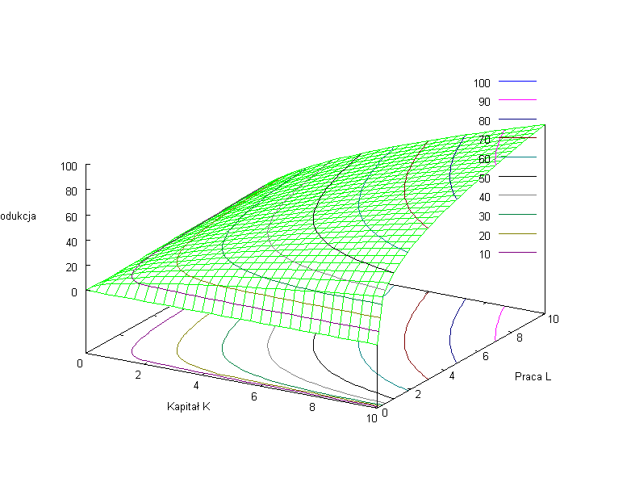
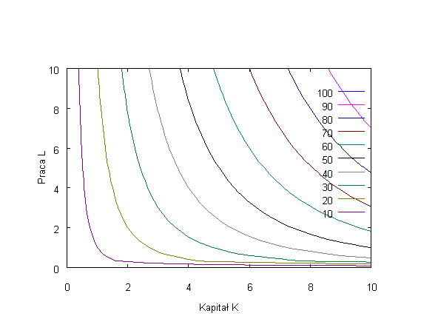

  The cost (expenditure) minimization problem - by analogy
The choice of firm space is reduced to two dimensions. The firm chooses between factors K(capital) and L (Labour). The technology are represented by the production function $Y =f\left(K,L \right)$Mapping the production function onto choice space creates an isoquant map: each point (a combination of capital, K, and labour, L) gives the same production level. Now we care about how much these isoquants differ in value --> production is measurable. The economy of scale matters.

Slide 38
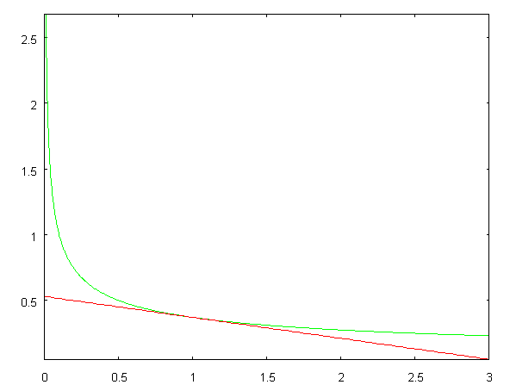
  The cost (expenditure) minimization problem - by analogy
Marginal Rate of Technical Substitution (MRTS)
MRTS measures how one factor can be substituted for another while keeping production constant.
  The isoquant shows combinations of K and L that yield the same production level.
  The slope of the isoquant indicates the amount of L that can be reduced for each additional unit of K to maintain the same production level.

Slide 39
  The cost (expenditure) minimization problem - by analogy
Cobb-Douglas vs. CES Production Function
Cobb-Douglas: Widely used due to simplicity and fixed factor shares.
The CES function is more universal but not easy to use in models [but you can find all results of calculations in textbooks].CES (Constant Elasticity of Substitution) offers:
  adjustable factor shares
  flexibility in modelling substitution of production factors.
A - efficiency parameter; represents the state of technology A>0
δ - parameter of relative share of individual factors in production 0<δ<1 (similarly as in the C-D alpha (1-alpha) function)
ρ - is the parameter of substitution of one factor for another -1 < ρ

Slide 40
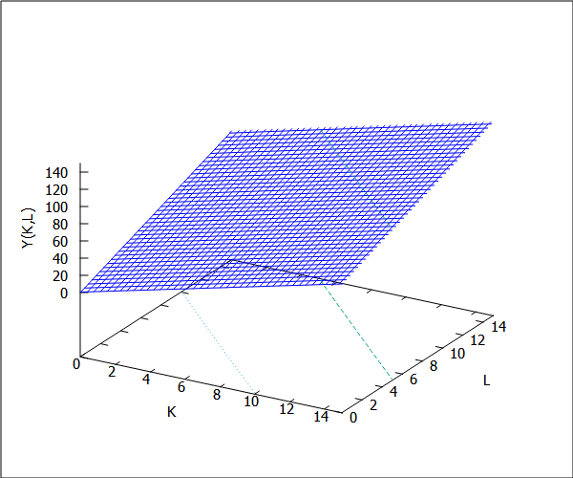
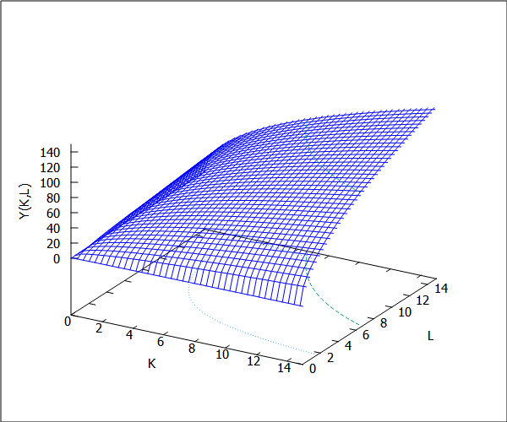
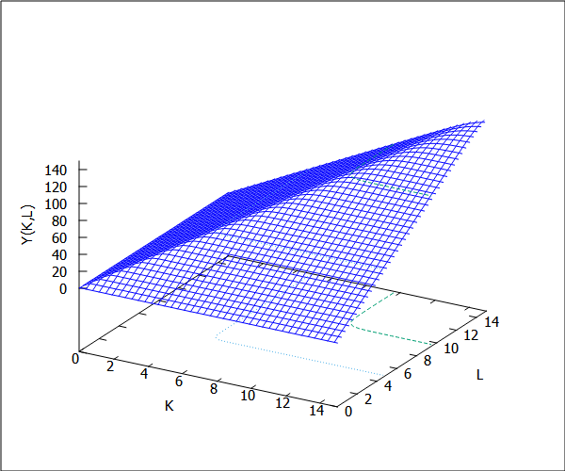
  The cost (expenditure) minimization problem - by analogy
Case of perfect substitution (ro = -1):
The CES function becomes linear
Case of partial substitution (ro -> 0): The CES function converges to the Cobb-Douglas (C-D) form
As ρρ approaches infinity, the CES function converges to the Leontief form: Y = max(aK,(1-a)L)
kill(all); /* Clear all previous definitions and variables */
load(draw); /* Load the drawing package for 3D plotting */
Y: 10 * (a * (K^(-ro)) + (1 - a) * (L^(-ro)))^(-1/ro);
/* Define the CES production function Y with elasticity parameter 'ro'
and distribution parameter 'a' (controls the share of K and L in production) */
a: 0.5; /* Set the distribution parameter 'a' (share of capital K in production) */
ro: 23; /* Set the elasticity of substitution parameter 'ro' range (-1, 0) and (0,inf) */
draw3d(
yrange = [0, 15], /* Define range for the y-axis (output Y) */
xrange = [0, 15], /* Define range for the x-axis (capital K) */
zrange = [0, 150], /* Define range for the z-axis (output Y) */
xlabel = "K", /* Label for x-axis (Capital K) */
ylabel = "L", /* Label for y-axis (Labor L) */
zlabel = "Y(K,L)", /* Label for z-axis (Output Y as a function of K and L) */
contour_levels = 5, /* Set the number of contour levels for the plot */
contour = both, /* Enable contour lines on both the base and surface */
explicit(''Y, K, 0.001, 19, L, 0.001, 19), /* Plot the CES function over specified ranges of K and L */
color = red, /* Set the plot color to red */
label(["ro =", 5, 5,20]),label([string(ro),5,5,22.5]) /* Add a label to indicate the value of 'ro' on the plot */
) $
/* Case of perfect substitution (ro = -1): The CES function becomes linear */
kill(all); /* Clear all previous definitions and variables */
Y: A * (delta * (K^(-ro)) + (1 - delta) * (L^(-ro)))^(-1/ro);
/* Define the CES production function Y with elasticity parameter 'ro'
and distribution parameter 'delta' for perfect substitution */
delta: 0.5; /* Set the share parameter 'delta' for factor K */
A: 10$ /* Set the scaling factor 'A' for the production function */
radcan(limit(''Y, ro, -1, plus));
/* Calculate the limit of Y as ro approaches -1 (perfect substitution),
simplifying the CES function to a linear form */
(%o4) /* Expected output: 5 * L + 5 * K */;
/* Case of partial substitution (ro -> 0): The CES function converges to the Cobb-Douglas (C-D) form */
kill(all); /* Clear all previous definitions and variables */
Y: A * (delta * (K^(-ro)) + (1 - delta) * (L^(-ro)))^(-1/ro);
/* Define the CES production function Y with elasticity parameter 'ro' and
distribution parameter 'delta' for factors K and L */
delta: 0.5; /* Set the share parameter 'delta' for factor K */
A: 10$ /* Set the scaling factor 'A' for the production function */
radcan(limit(radcan(''Y), ro, 0, plus));
/* Calculate the limit of Y as ro approaches 0 (partial substitution),
simplifying the CES function to the Cobb-Douglas form */
(%o4) /* Expected output: 10 * sqrt(K) * sqrt(L) */;

Slide 41
  The cost (expenditure) minimization problem - by analogy
The name of this function is also its characteristic: It is a function with constant elasticity of substitution. Elasticity of substitution is a measure of the percentage change in the proportion of production factors in relation to the percentage change in MRTS. It is a measure of the curvature of the isoquant - it is constant and defined by the parameter ρ

Slide 42
  The cost (expenditure) minimization problem - by analogy
L
L/K
K

Slide 43
  The cost minimization problem
Firms are cost-effective, i.e.: given:
prices of factors of production r, in
a technology Y(K,L)
they will employ such a combination of factors of production as to minimize the cost of producing a given quantity of output Y → the primary problem takes the form:
subject to constraint

Slide 44
  The cost minimization problem
L
L*
K*
K

Slide 45
  The cost minimization problem
subject to
We use K and L to achieve the desired level of production with a given technology.
Objective function
F.O.C

Slide 46
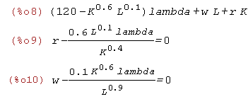
  The cost minimization problem
kill(all)$ /* Clear all previous definitions and variables */
assume(K>0, L>0, r>0, w>0, Y>0, lambda>0, a>0, b>0, a<1, b<1, _Y>0, A>0)$
/* Set assumptions for variables: K, L, r, w, Y, lambda, a, b, _Y as positive.
Also, a and b are between 0 and 1 */
declare(a, constant, b, constant, A, constant)$
declare(a, noninteger, b, noninteger);
/* Declare 'a' and 'b' as non-integer values for further symbolic manipulation */
/* Declare 'a', 'b', and 'A' as constants for symbolic manipulation */
Y: A * (K^(a)) * (L^(b))$
/* Define the production function Y as a function of K and L with scaling factor A and exponents a and b */
Lagr: (r * K + w * L) + lambda * (_Y - Y)$
/* Define the Lagrangian function with the objective function (r * K + w * L)
and the constraint (_Y - Y) multiplied by lambda */
eq1: diff(Lagr, K, 1) = 0$ /* First-order condition with respect to K */
eq2: diff(Lagr, L, 1) = 0$ /* First-order condition with respect to L */
eq3: diff(Lagr, lambda, 1) = 0$ /* First-order condition with respect to lambda (constraint) */
/* Solve the equations sequentially since direct substitution does not work */
/* From the third equation, solve for K */
solve(eq3, K)$ K: rhs(%[1])$ /* Extract the value of K from the solution */
/* From the second equation, solve for lambda */
solve(''eq2, lambda)$ lambda: ''rhs(%[1])$ /* Extract the value of lambda from the solution */
/* From the first equation, solve for L */
solve(''eq1, L)$ L: rhs(%[1])$ /* Extract the value of L from the solution */
/* Display the final values of L, K, and lambda */
print("Optimal value of L:", ''L)$
print("Optimal value of K:", ''K)$
print("Optimal value of lambda:", ''lambda)$
We solve the system of 3 equations by substitution. In textbooks it is done in such a way that we get interpretable conditions along the way, i.e.:
MRTS = price ratio

Slide 47
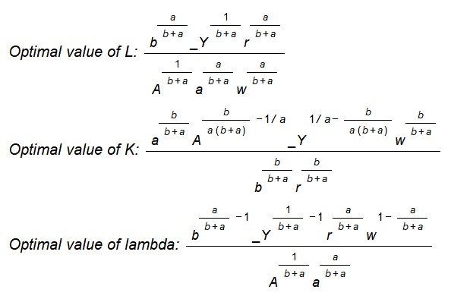
  The cost minimization problem
Employing K* and L* gives the minimum cost of producing Y.
There are also functions of demand for production factors (analogous to consumer choice)
  Conditional Demands:
  K = f(r,w,Y) and L = f(r,w,Y)
The interpretation of lambda is Marginal Cost: how much will the cost increase when we „relax" the constraint and increase the production of Y by a unit
K*(r,w,Y)

Slide 48
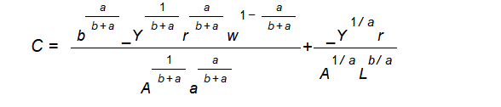
  The cost minimization problem
We can insert the obtained solutions K*(r,w,Y) and L*(r,w,Y) into the cost function and we will get an intermediate cost function that depends on the market price variables: r,w, on the parameters defining the technology and the production volume Y.
K*(r,w,Y)
L*(r,w,Y)

Slide 49
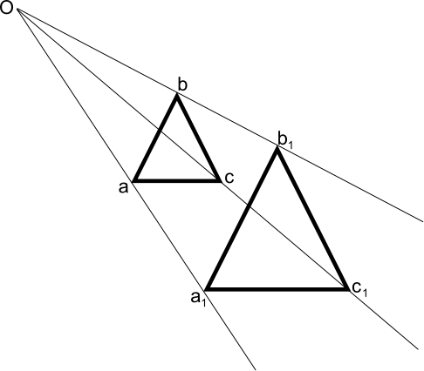
  The cost minimization problem
L
kill(all)$ /* Clear all previous definitions and variables */
assume(X1>0, X2>0, p>0, w1>0, w2>0, MP1>0, MP2>0, a>0, b<0)$
/* Set assumptions for variables: X1, X2, p, w1, w2, MP1, MP2 as positive,
a as positive, and b as negative. */
Y: A * (K^a) * (L^b);
/* Define the production function Y as a function of capital (K) and labor (L)
with parameters A, a, and b, where a and b represent the output elasticities of K and L. */
MP_K: diff(Y, K, 1)$
/* Calculate the marginal product of capital (MP_K) by taking the first derivative of Y with respect to K */
MP_L: diff(Y, L, 1)$
/* Calculate the marginal product of labor (MP_L) by taking the first derivative of Y with respect to L */
eq1: MRTS: MP_K / MP_L = r / w;
/* Define the Marginal Rate of Technical Substitution (MRTS) as the ratio of the marginal products
(MP_K / MP_L) and set it equal to the ratio of input prices (r/w).
This indicates that the spending on capital (K) and labor (L) is in the same proportion to achieve optimal production. */
print("Production function Y:", Y);
print("Marginal Product of Capital (MP_K):", MP_K);
print("Marginal Product of Labor (MP_L):", MP_L);
print("MRTS Condition (eq1):", eq1);
L
K
L
Constant proportion of expenditure on K to expenditure on L depending on the parameters of the production function
--> S= a/b
„In production theory, homothetic functions are a class of functions where the ratio of input factors remains constant along expansion paths. This means that if inputs are scaled by a certain factor, output also scales by a function of that factor, preserving the production structure. Homothetic functions are particularly useful for analyzing production processes where returns to scale are consistent. These functions allow for a straightforward analysis of proportional changes in input levels, which makes them valuable for studying cost functions and input substitution in economic models.”

Slide 50
  The cost minimization problem
The % change in factor prices is fully compensated by the % change in the factor ratio (technology.
For the C-D function, elasticity of substitution = 1
The % change in the market price ratio
L
Restrictive assumption for C-D: The division of total income between factors of production depends on technology parameters.
dL/dK
L/K
K

Slide 51
Contemporary Microeconomic Models of Macroeconomics - Welcome to Arrow–Debreu World
General equilibrium models - we start with individuals (homo oeconomicus [assumptions - axioms]) and end with the entire economy.
Kenneth Arrow, Gérard Debreu did what physics failed to do [the model of the behavior of atoms does not explain the behavior of the universe].
We can start with, two optimization problems and a few tautological equalities from the scheme of circulation in the economy are enough, to do it.
Kenneth Arrow
The economy is:
N1 consumers
N2 goods and services
N3 factors of production
N2 markets for goods and services
and their prices
N3 markets for factors of production and their prices
and …
the mechanism
that makes it all clear
Gérard Debreu

Slide 52
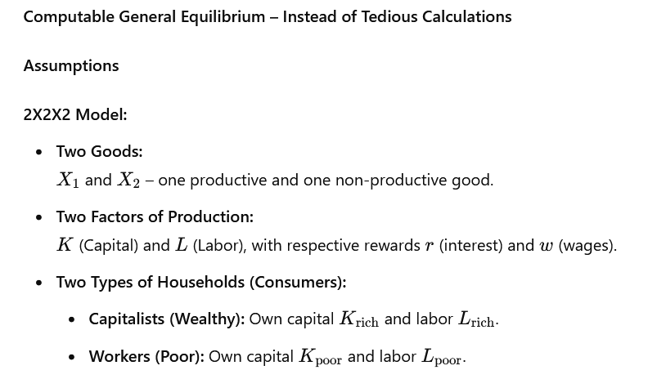
Contemporary Microeconomic Models of Macroeconomics - Welcome to Arrow–Debreu World

Slide 53
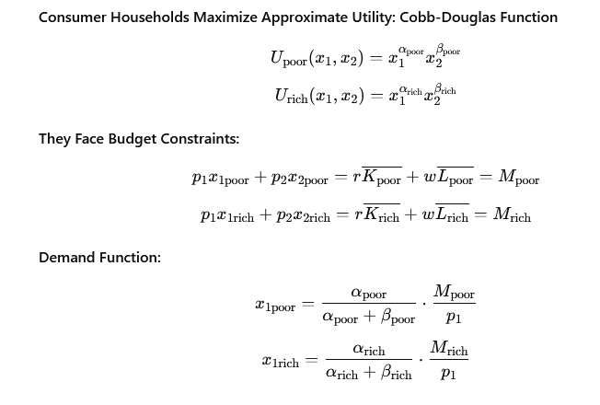
Contemporary Microeconomic Models of Macroeconomics - Welcome to Arrow–Debreu World

Slide 54
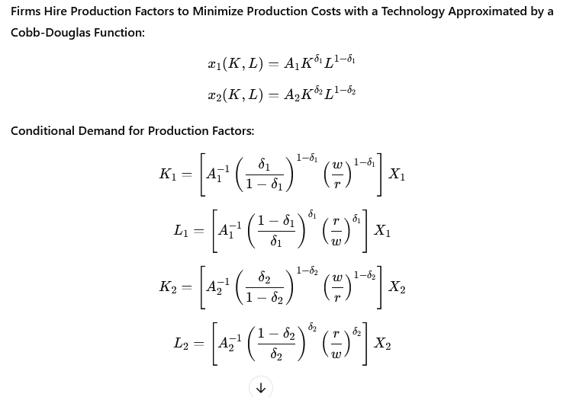
Contemporary Microeconomic Models of Macroeconomics - Welcome to Arrow–Debreu World

Slide 55
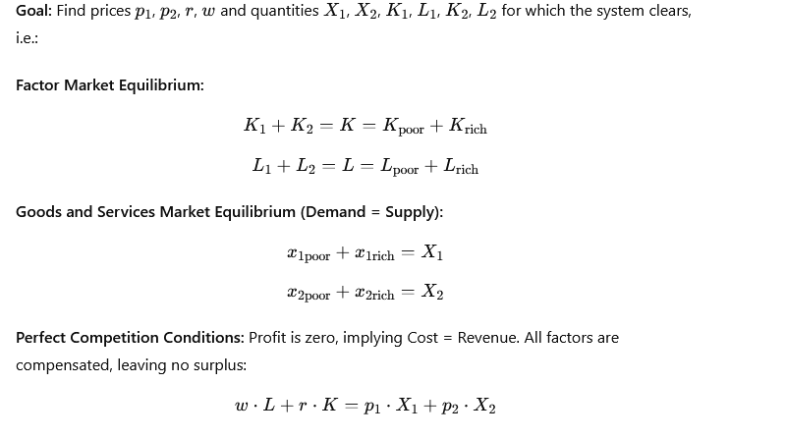
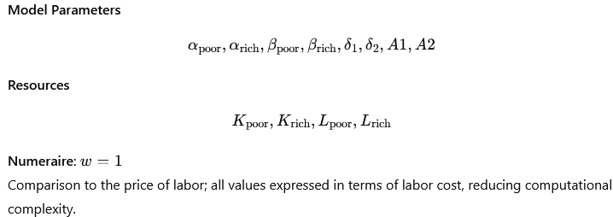
Contemporary Microeconomic Models of Macroeconomics - Welcome to Arrow–Debreu World

Slide 56
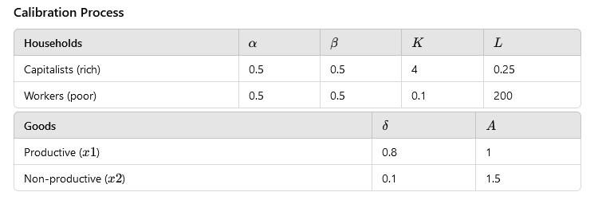
Contemporary Microeconomic Models of Macroeconomics - Welcome to Arrow–Debreu World
Interesting facts: 20 years ago, in large NBP models, these parameters for Poland were taken from the US economy :)

Slide 57
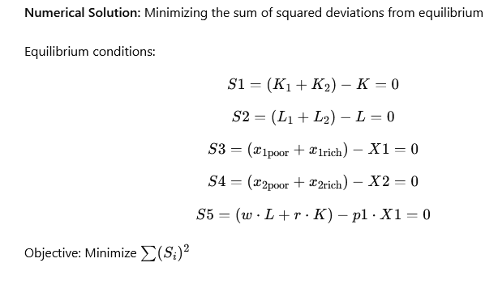
Contemporary Microeconomic Models of Macroeconomics - Welcome to Arrow–Debreu World

Slide 58
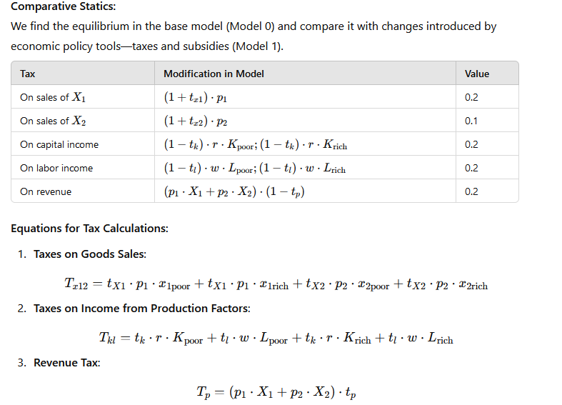
Contemporary Microeconomic Models of Macroeconomics - Welcome to Arrow–Debreu World

Slide 59
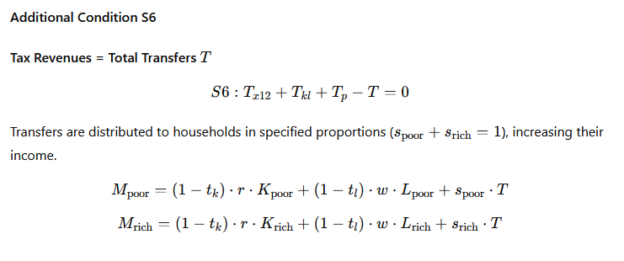
Contemporary Microeconomic Models of Macroeconomics - Welcome to Arrow–Debreu World

Slide 60
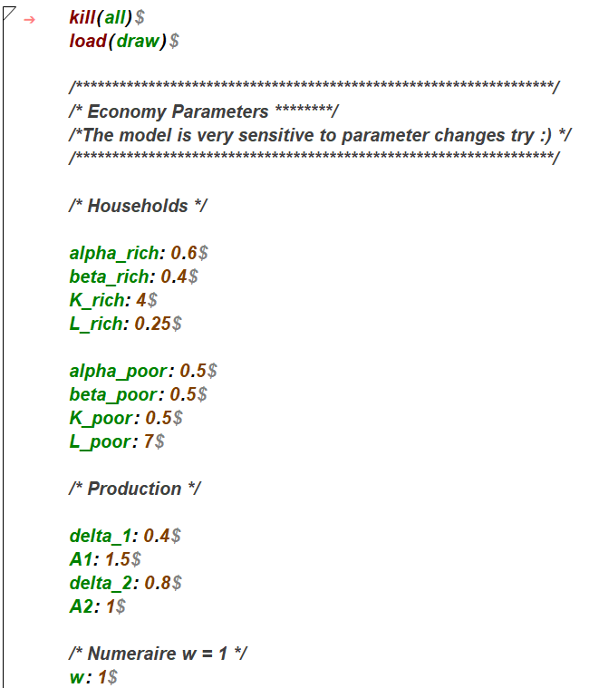
Contemporary Microeconomic Models of Macroeconomics - Welcome to Arrow–Debreu World
Open Maxima's CGE2.wxm file and run it cell by cell.

Slide 61
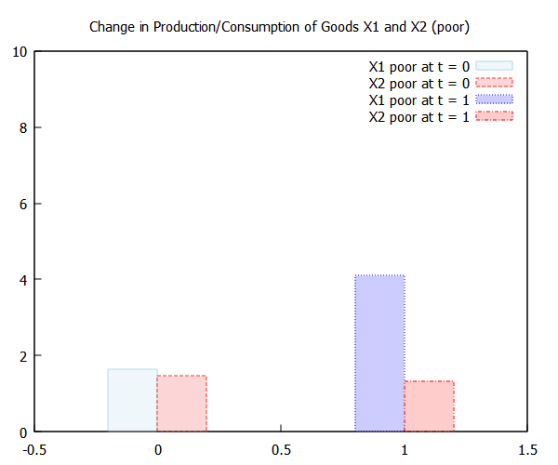
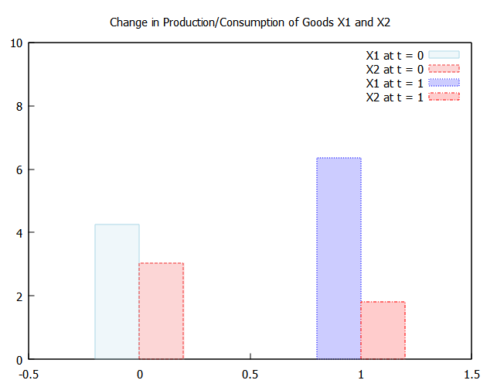
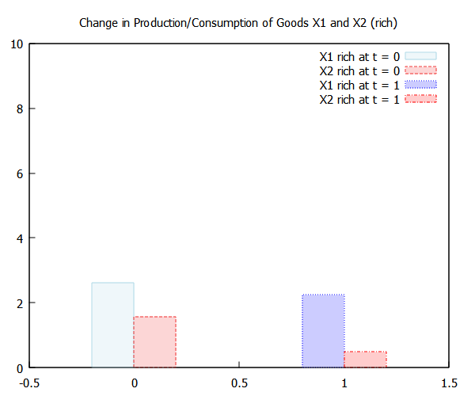
Contemporary Microeconomic Models of Macroeconomics - Welcome to Arrow–Debreu World

Slide 62
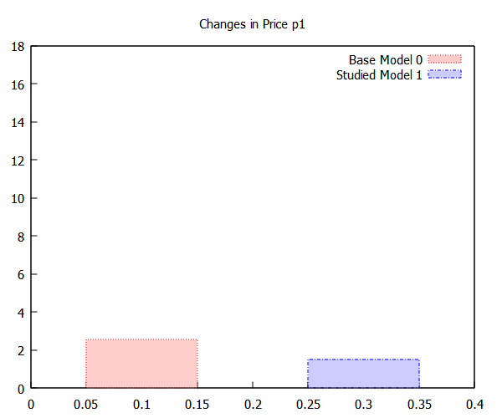
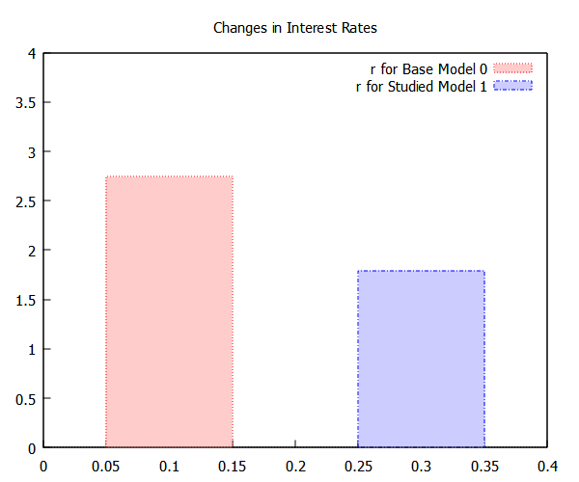
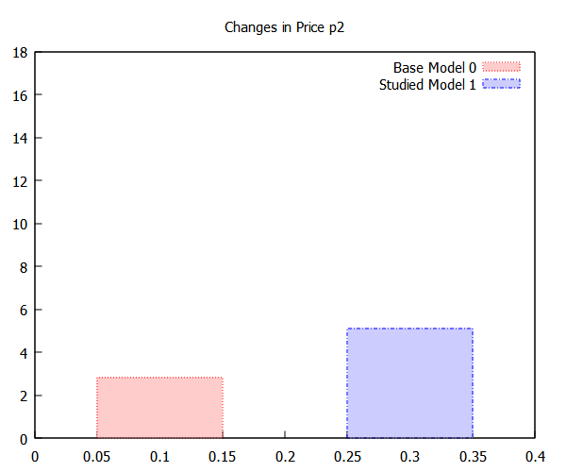
Contemporary Microeconomic Models of Macroeconomics - Welcome to Arrow–Debreu World

Slide 63
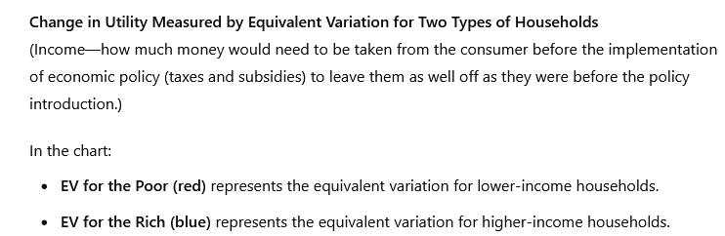
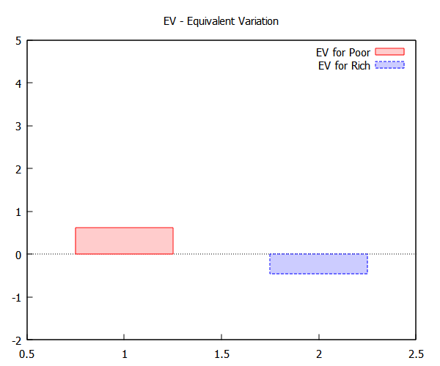
Contemporary Microeconomic Models of Macroeconomics - Welcome to Arrow–Debreu World

Slide 64
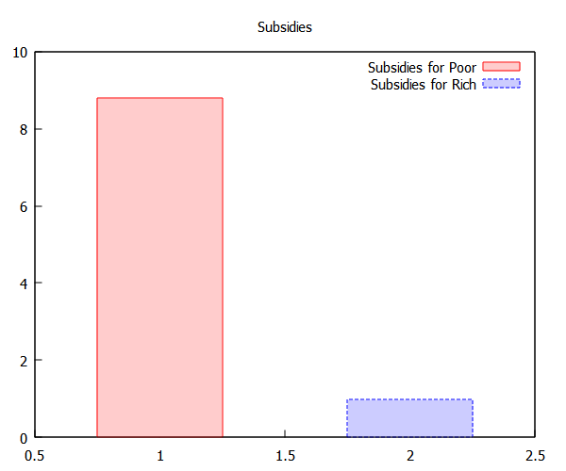
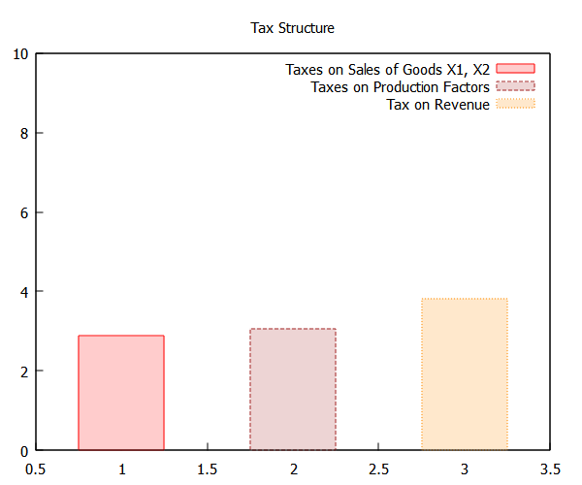
Contemporary Microeconomic Models of Macroeconomics - Welcome to Arrow–Debreu World

